Slide 1
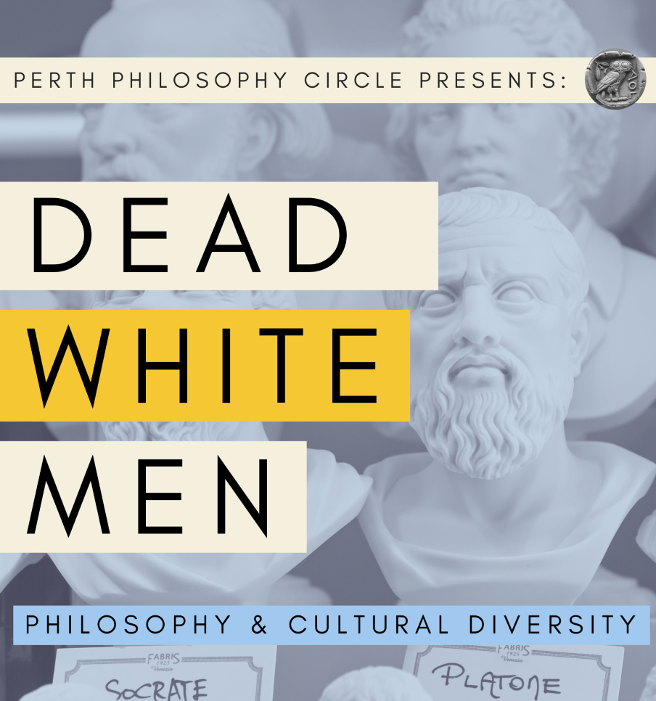
Philosophy and Cultural Diversity

Slide 2
The Argument:
Philosophy should be ‘opened up’, ‘liberated’, or ‘taken back’, so that it can finally reflect the diversity of the world’s philosophical traditions.

Slide 3
However…
Criticisms of philosophy for being ‘Eurocentric’, are not as straight forward as we might assume.

Slide 4
Sections:
Statues and Dead White Men
The Eurocentrism of Philosophy
Multicultural Philosophy as European Project
‘The Free Marketplace of Ideas’

Slide 5
1
Statues and Dead White Men

Slide 6
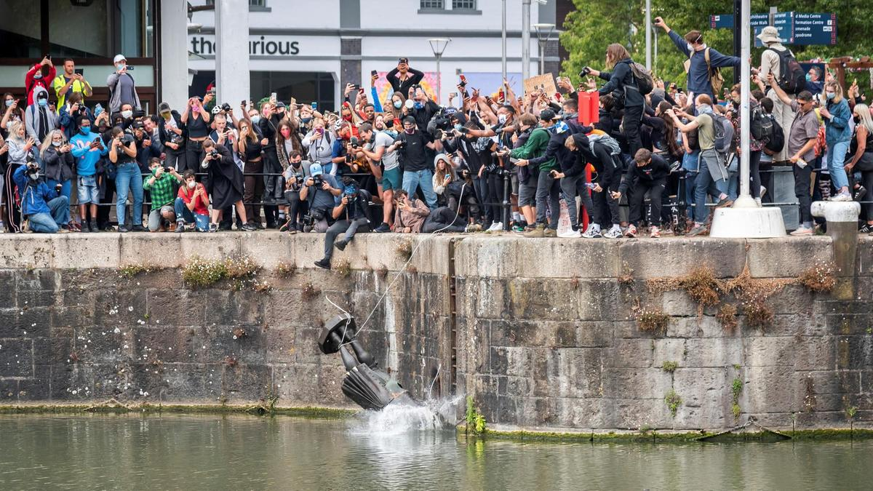

Slide 7
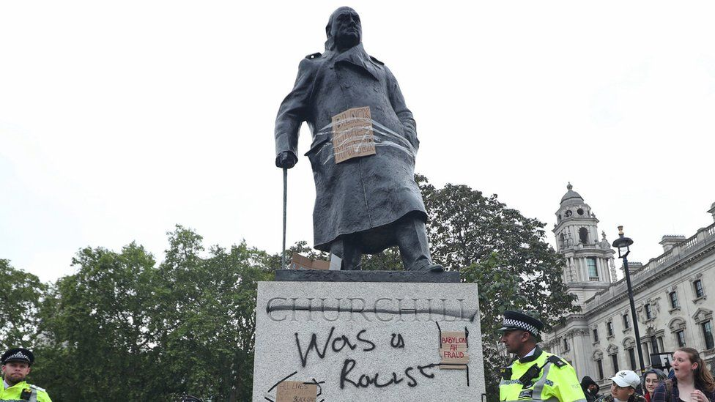

Slide 8
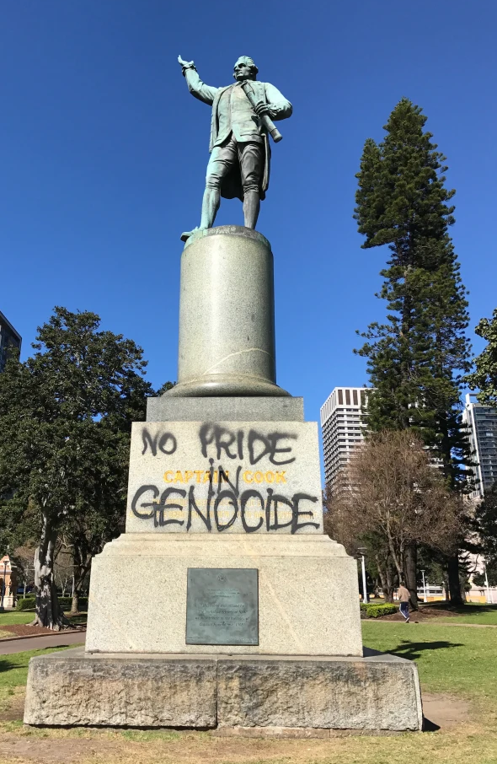
“Prime Minister Malcolm Turnbull likened the act to the historical revision undertaken by Soviet dictator Joseph Stalin, describing it as a ‘deeply disturbing and totalitarian campaign to not just challenge our history but to deny it and obliterate it’.”
SMH, April 2018

Slide 9
Historical revisionism is now an important part of a progressive politics of identity.

Slide 10
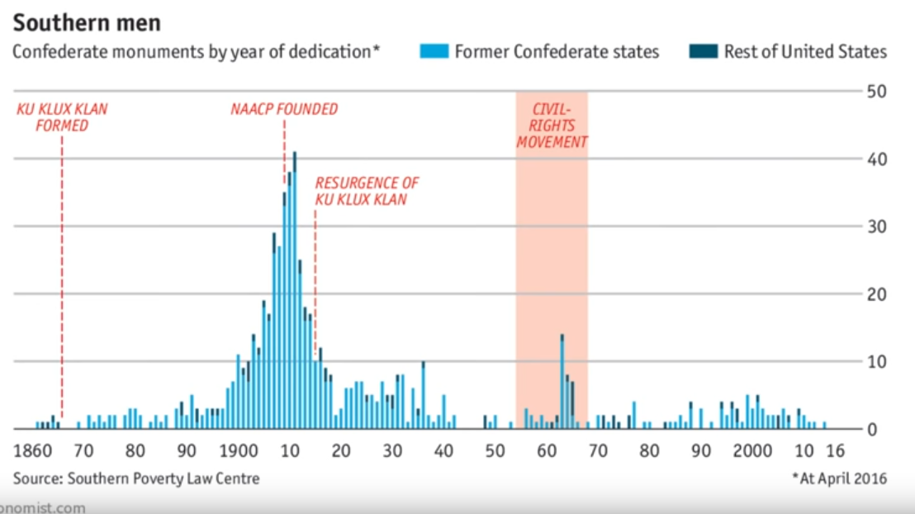

Slide 11
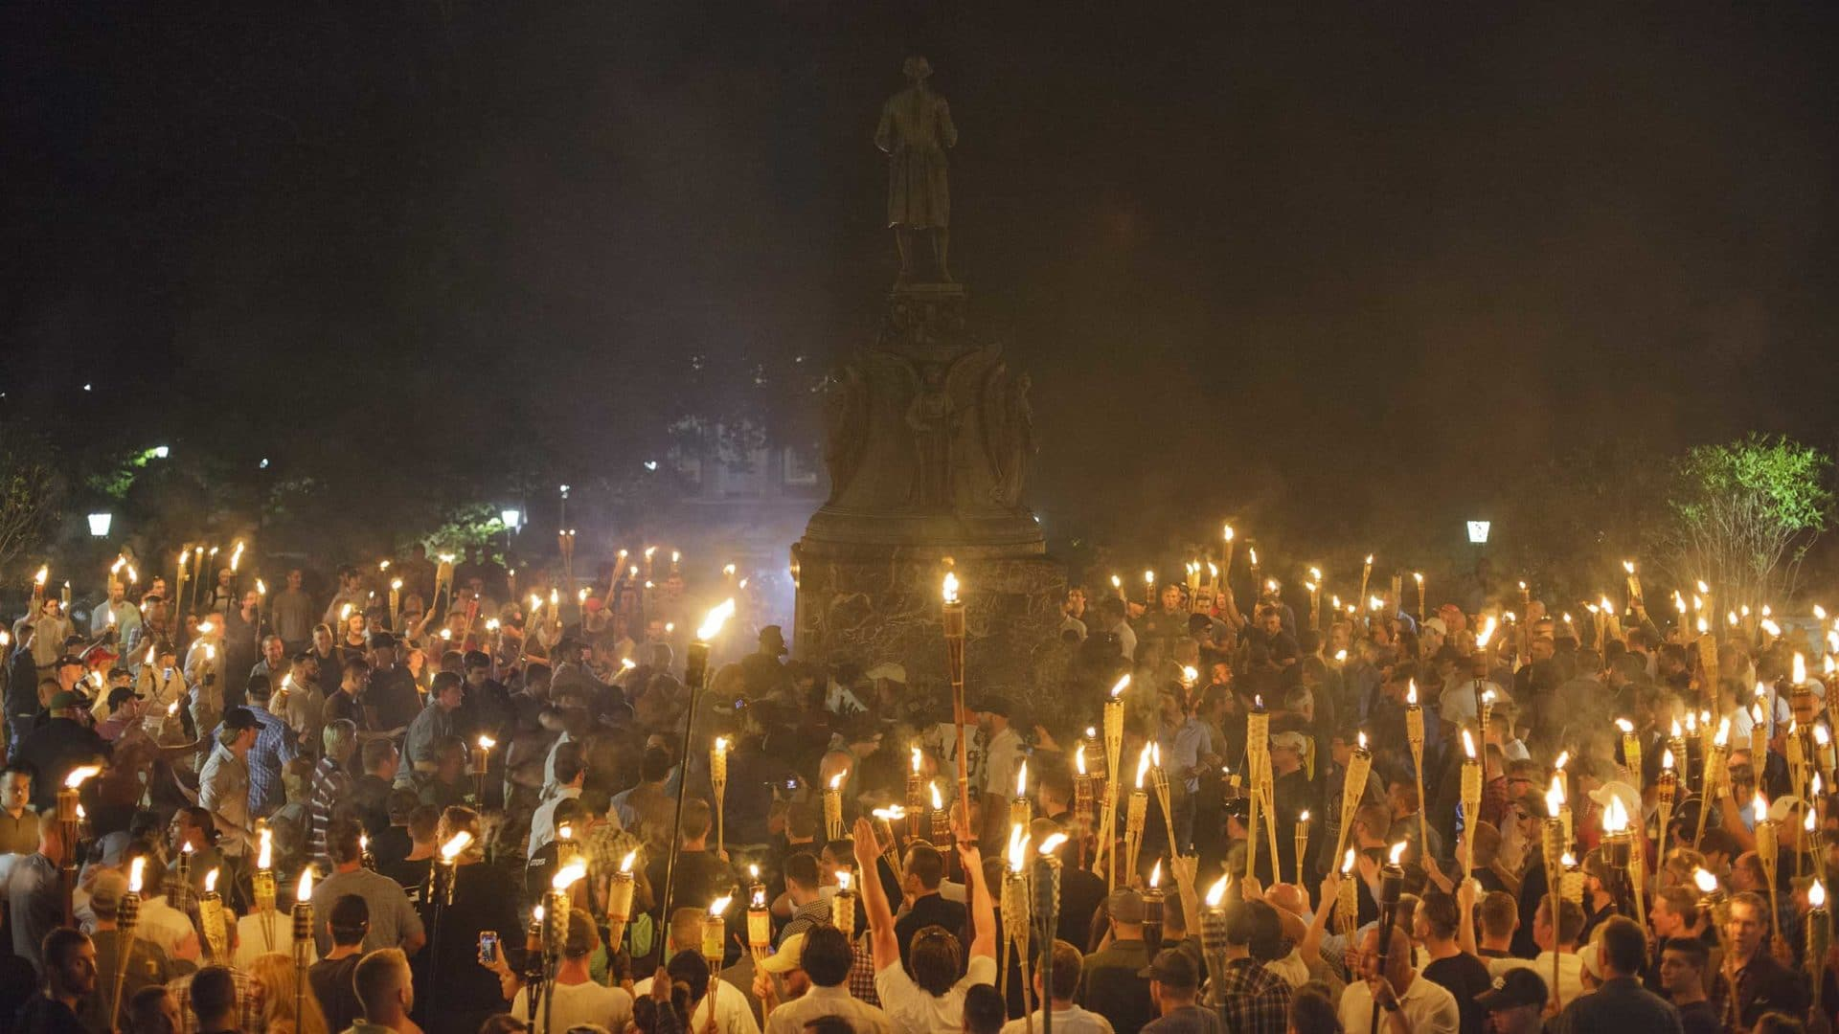
Oh! What a Lovely Culture War

Slide 12
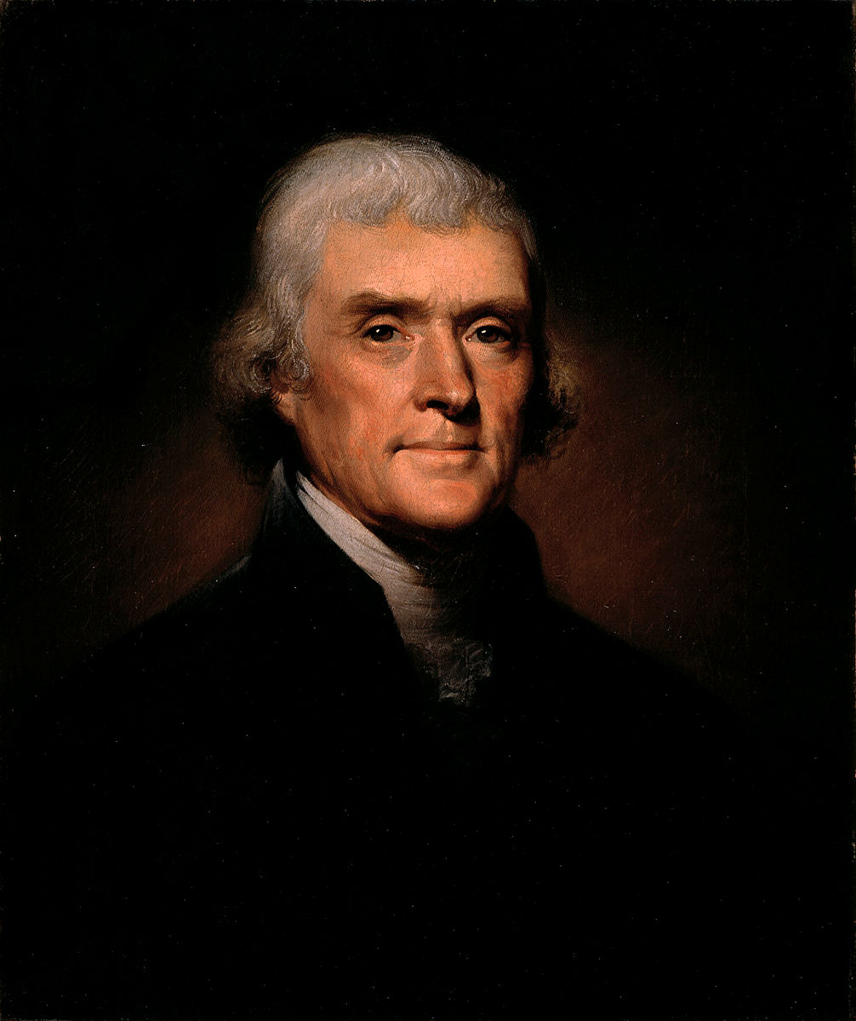

Slide 13
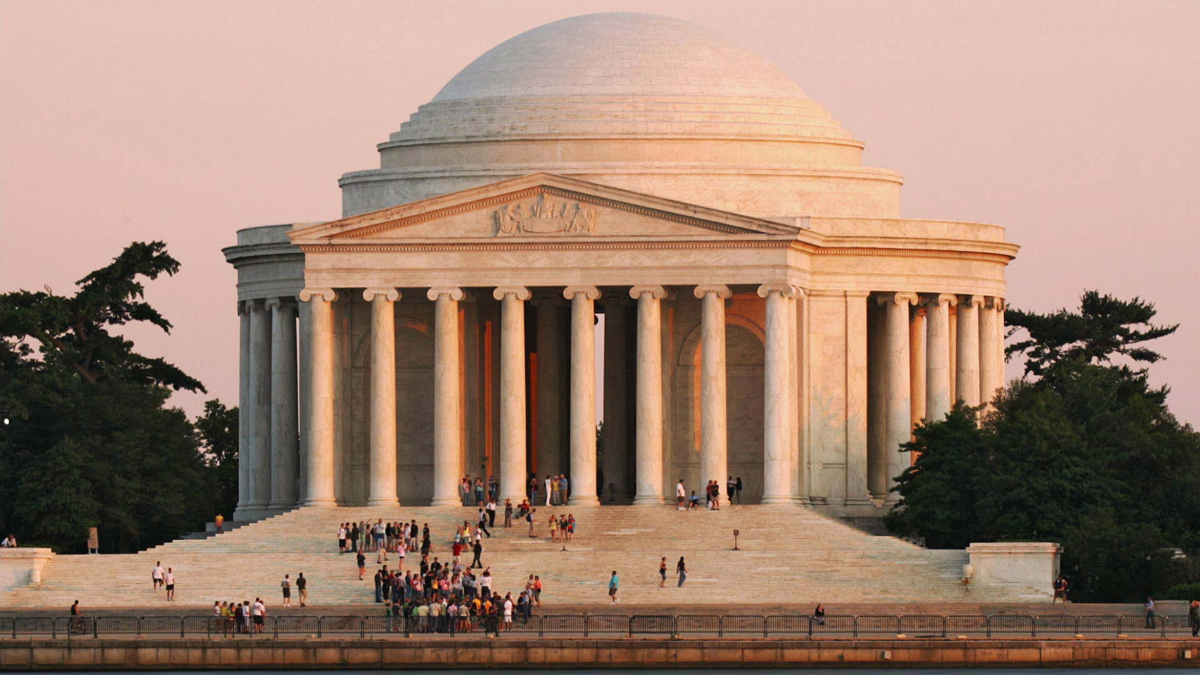

Slide 14
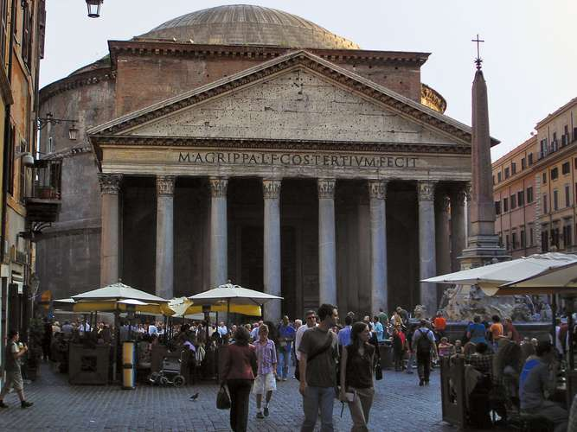

Slide 15
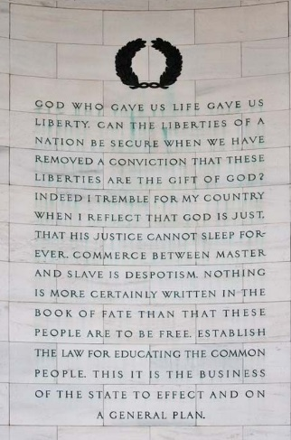
God who gave us life gave us liberty. Can the liberties of a nation be secure when we have removed a conviction that these liberties are the gift of God? Indeed I tremble for my country when I reflect that God is just, that his justice cannot sleep forever. Commerce between master and slave is despotism. Nothing is more certainly written in the book of fate than that these people are to be free. Establish the law for educating the common people. This it is the business of the state to effect and on a general plan.

Slide 16
“…Nor is it less certain that the two races, equally free, cannot live in the same government. Nature, habit, opinion has drawn indelible lines of distinction between them.”
- Jefferson

Slide 17
“The civil religion has been implicitly or explicitly a religion of white people for most of its history.”

Slide 18
2
The Eurocentrism of Philosophy

Slide 19
“No other humanities discipline demonstrates [the same level of] systematic neglect of most of the civilizations in its domain [as philosophy]. The present situation is hard to justify morally, politically, epistemically or as good educational and research training practice.”
Jay Garfield, Brian Van Norden
“If Philosophy Wont Diversify, Let’s Call it What it Really Is”
The New York Times, May 2016

Slide 20
“Philosophy as a discipline has a serious diversity problem, with women and minorities underrepresented at all levels among students and faculty, even while the percentage of these groups increases among college students. Part of the problem is the perception that philosophy departments are nothing but temples to the achievement of males of European descent.”
Jay Garfield, Brian Van Norden

Slide 21
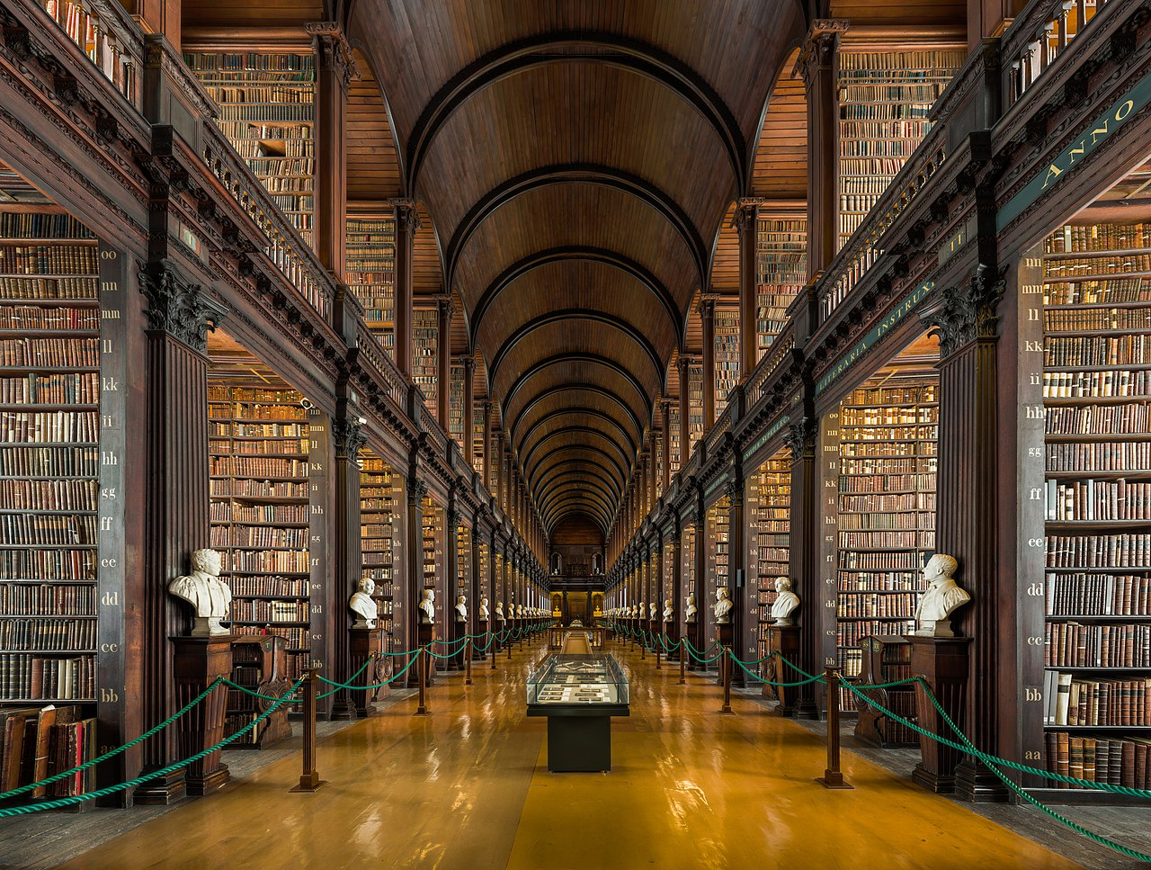

Slide 22
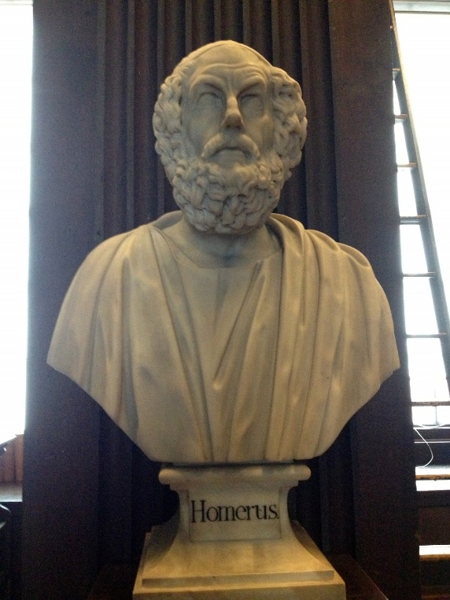
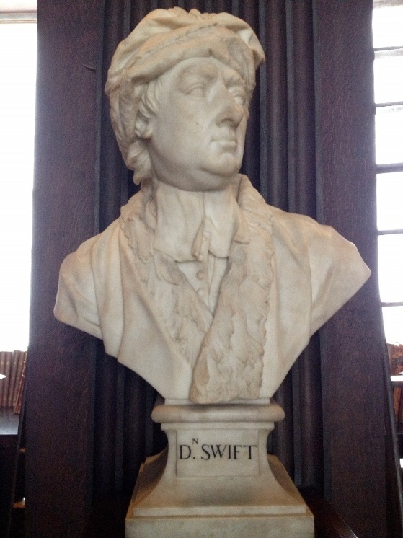
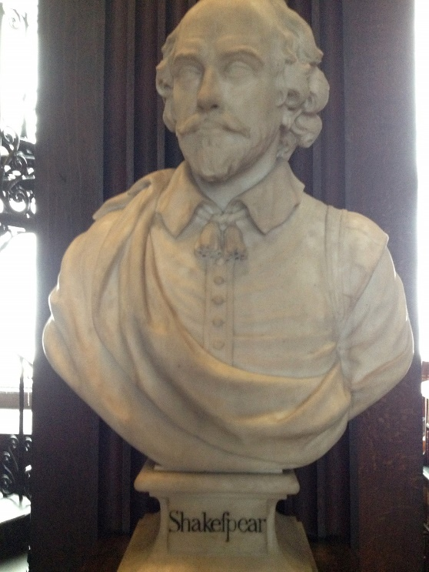
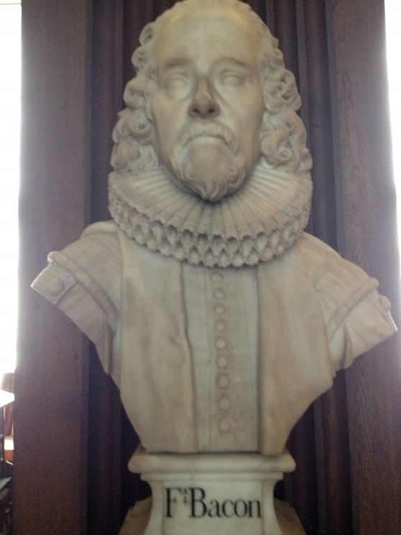
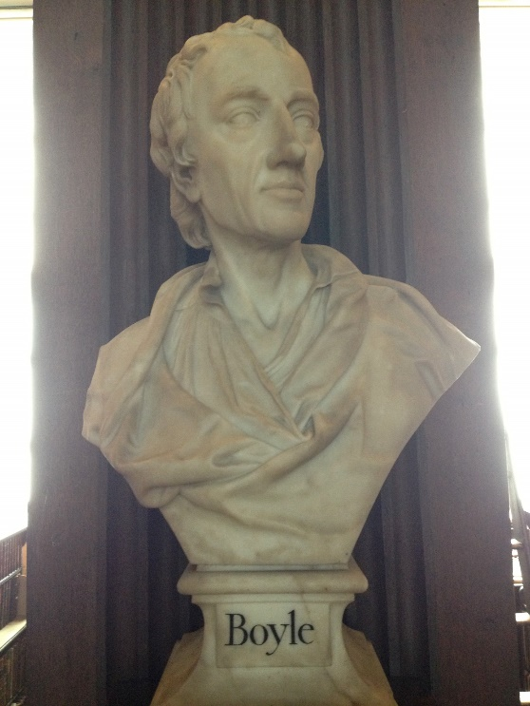
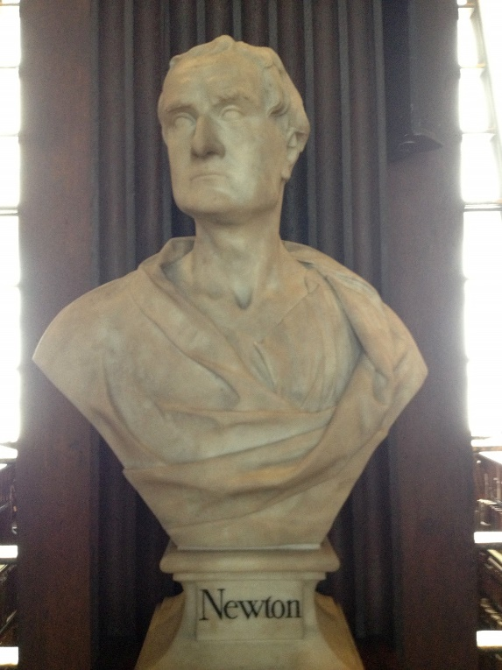
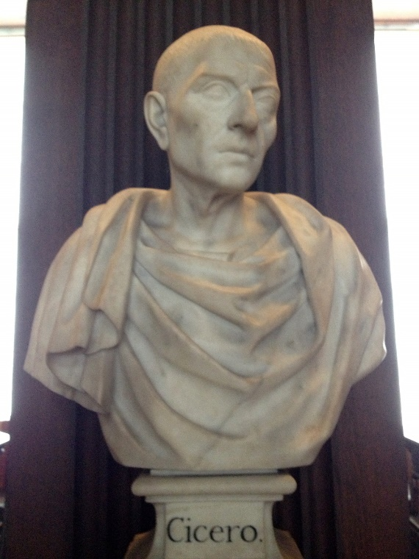
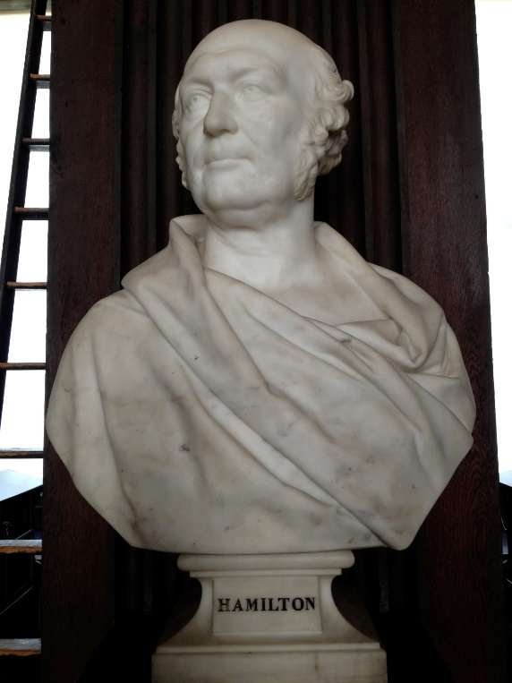
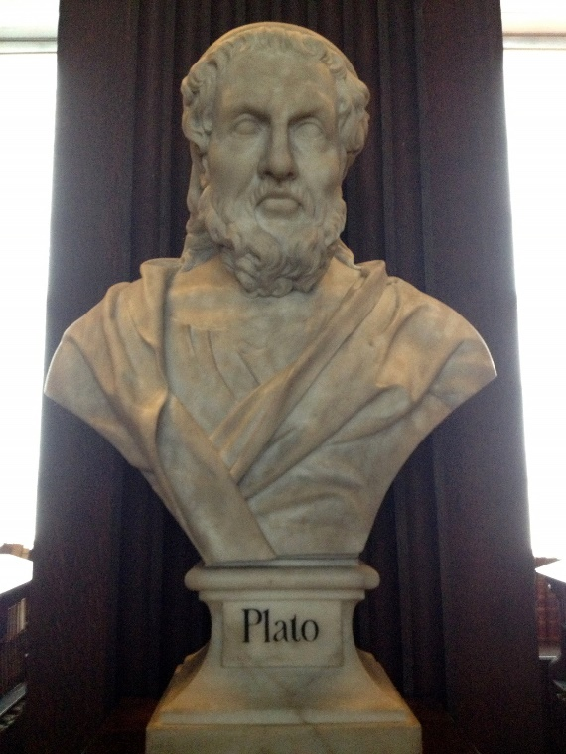
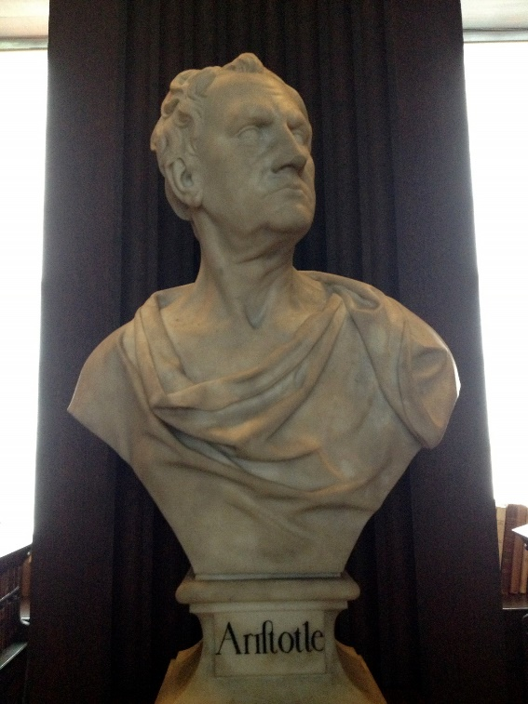
Photos by Arran Henderson

Slide 23
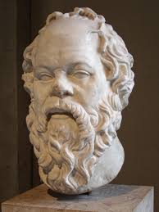
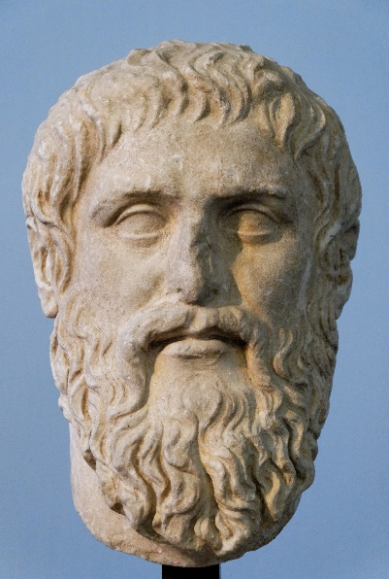


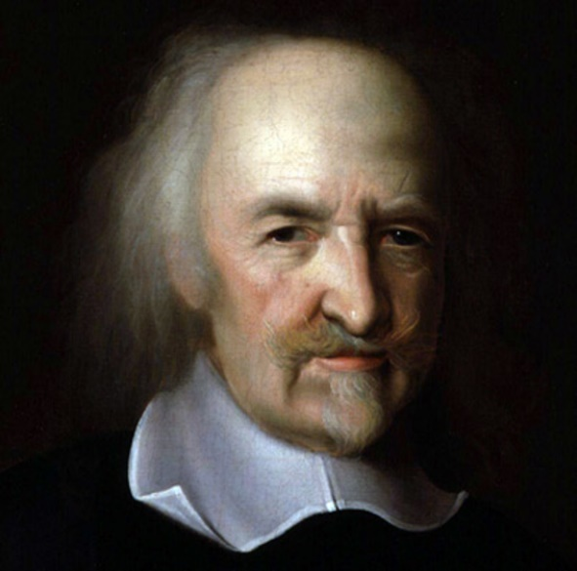
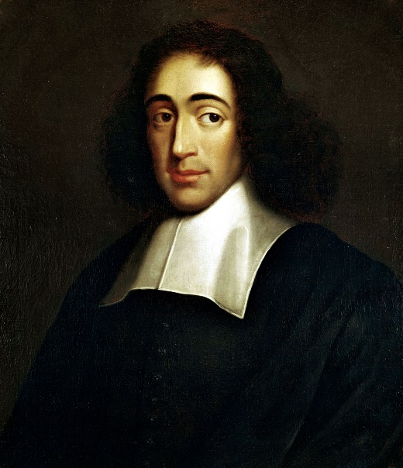

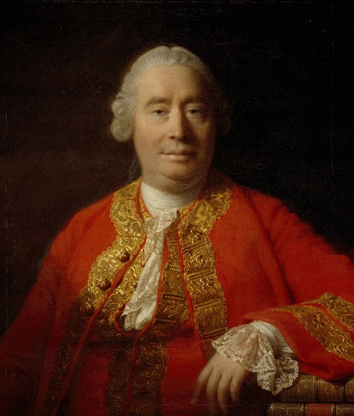
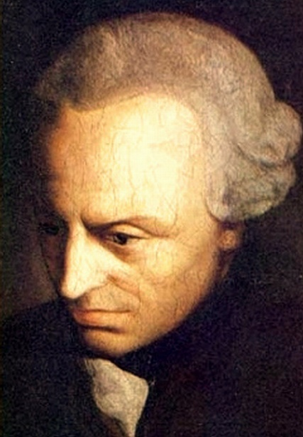
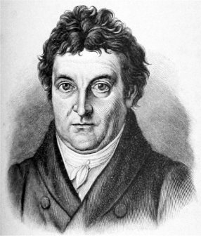
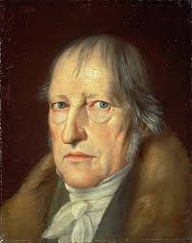
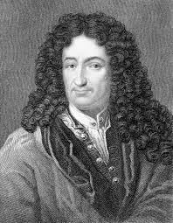
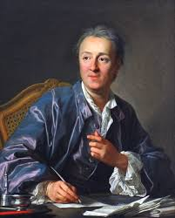
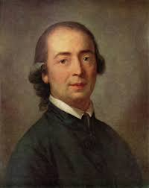
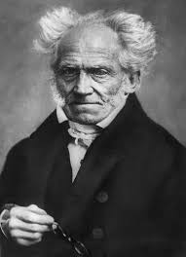
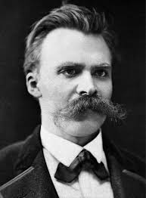
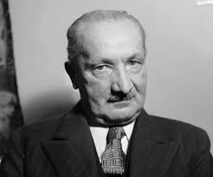
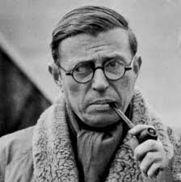

Slide 24
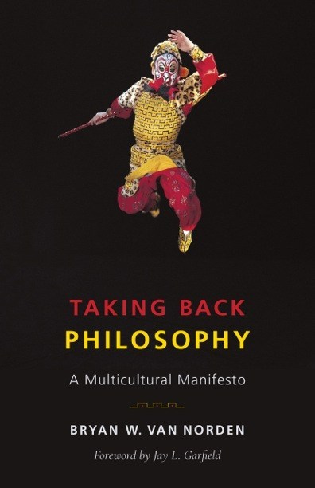

Slide 25
“…everyone in our profession who has studied or taught [non-Western philosophical traditions] seriously agrees that… it is of the same kind as philosophy pursued in the West, and that it addresses similar issues, albeit with distinct perspectives, and that it offers distinctive arguments and positions.”

Slide 26
Therefore,
“…ignoring non-Western philosophy in our research, curriculum, and hiring decisions is deeply racist.”

Slide 27
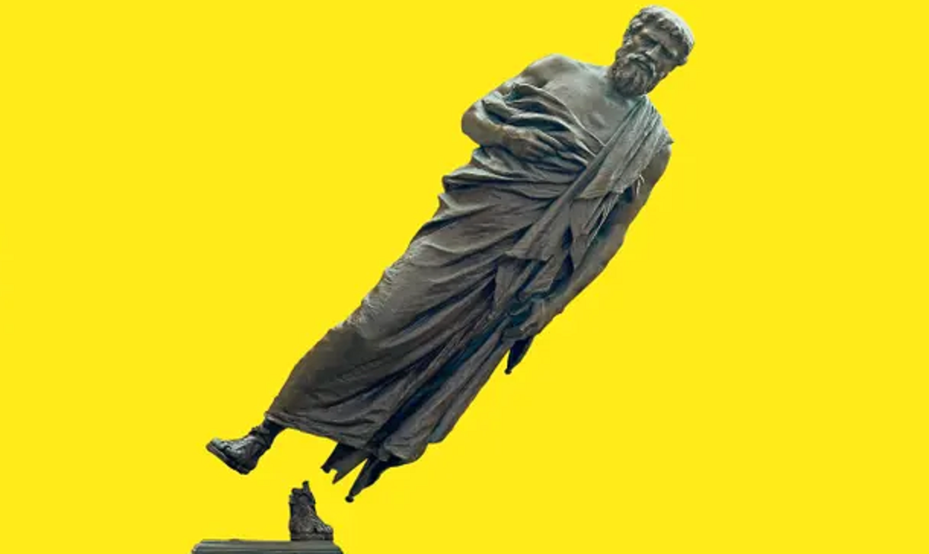
“Are Soas Students Right to ‘Decolonise’ their Minds from Western Philosophers?”
Kenan Malik, The Guardian, February 2017

Slide 28

“They Kant be serious!”
The Daily Mail
“Great thinkers too male and pale, students declare.”
- The Times.

Slide 29
3
Multicultural Philosophy as European Project

Slide 30
Philosophy

Slide 31
Philosophy
World Philosophies

Slide 32
Philosophy is a ‘global’ ‘phenomenon of culture’…

Slide 33
Philosophy is a ‘global’ ‘phenomenon of culture’…
…it is found wherever human culture is found, and…

Slide 34
Philosophy is a ‘global’ ‘phenomenon of culture’…
…it is found wherever human culture is found, and…
…takes on diverse forms like culture itself.

Slide 35
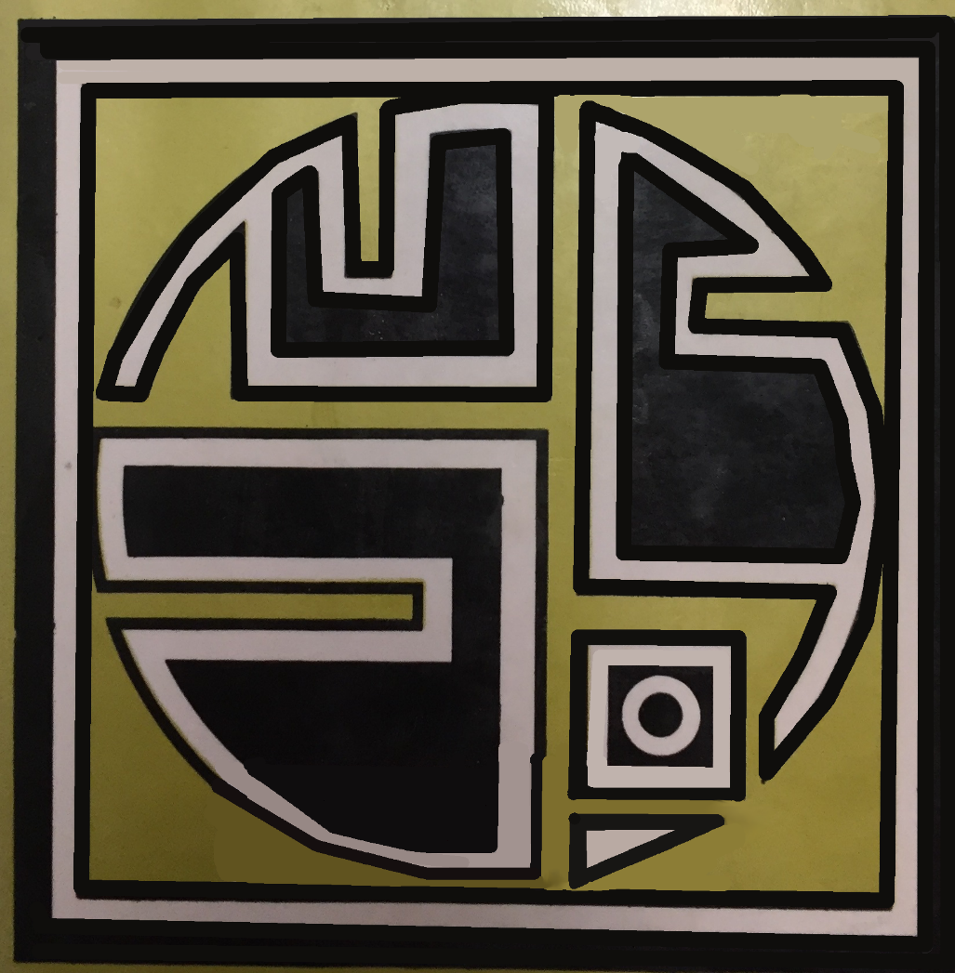

Slide 36
Comparative Philosophy

Slide 37
“We can’t set out strict rules for what does or doesn’t count as philosophy, but we can see that it has a set of shared features and that an intellectual tradition should be treated as philosophy if it shares enough of them.”
Julian Baggini, How the World Thinks

Slide 38
“People are doing philosophy, badly or well, whenever they set their minds to a systematic investigation of the nature of the world, selfhood, language, logic, value, the human good, the sources and justifications of knowledge, the nature and limits of human reason. When such issues are dealt with purely by myth or dogma it is religion and folklore, not philosophy. When methods have been agreed upon to answer the questions empirically, inquiry becomes scientific, not philosophical.”
Julian Baggini, How the World Thinks

Slide 39

Science
Philosophy
Myth
Religion

Slide 40
Philosophy is…
…the attempt “to understand how things in the broadest possible sense of the term hang together in the broadest possible sense of the term.”

Slide 41
Φιλοσοφία (philosophia)
'love of wisdom'

Slide 42
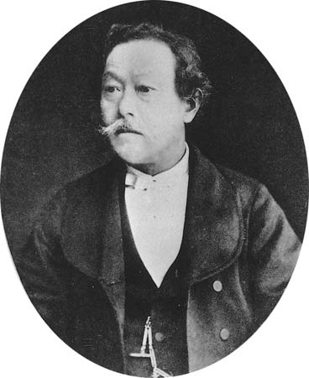
哲学 (tetsu-gaku)
‘study of wisdom’
西周 Nishi Amane
（１８２９－１８９７）

Slide 43
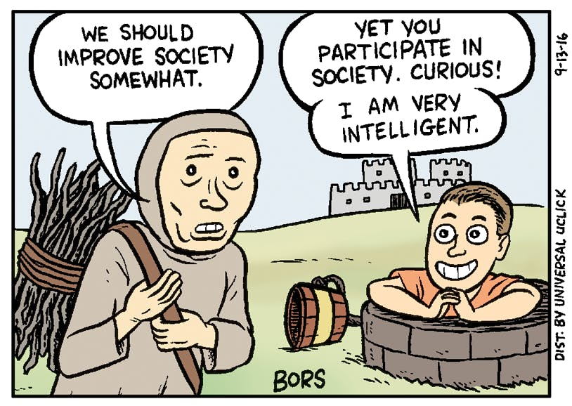

Slide 44
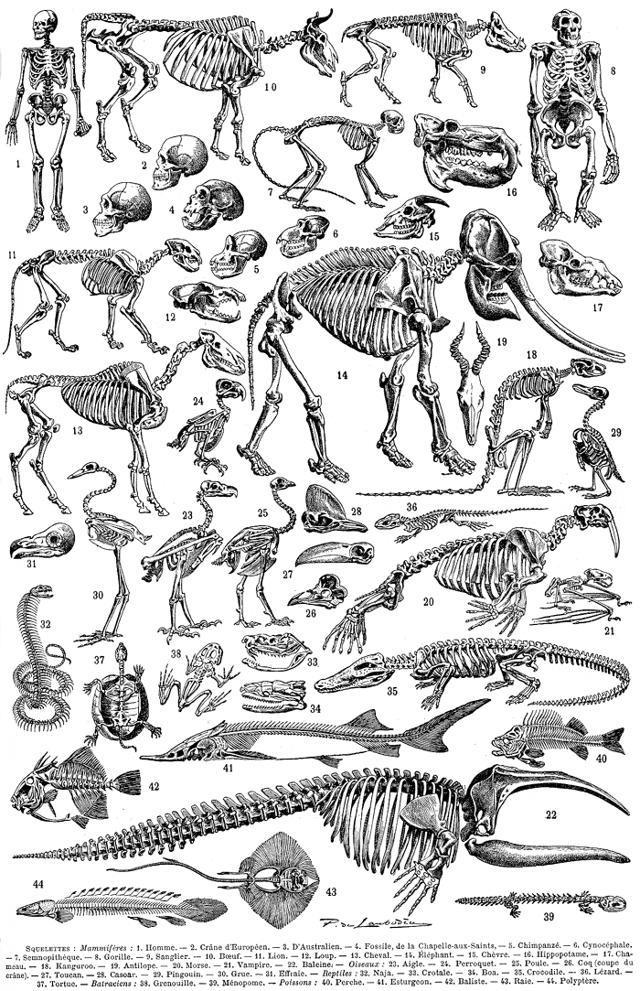

Slide 45
Comparative Linguistics
Comparative Mythology
Comparative Religion

Slide 46
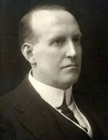
Just as physiology made scarcely any progress so long as the vertebrates only were analysed: just as linguistics allowed what is of essential interest to escape so long as it did not go beyond the grammatical study of a single language even though pursued through its many dialects; so philosophy cannot achieve positivity so long as its investigations are restricted to the thought of our own civilization.”
Paul Masson-Oursel, Comparative Philosophy, Kegan Paul, Trench, Trubner & Co Ltd, 1926, p. 33.
Paul Masson-Oursel
(1882-1956)

Slide 47
“To borrow an analogy from the Zimbabwean philosopher Joram Tarusarira, understanding the philosophical framework of a people is like understanding the software their minds work on…”
Julian Baggini, How the World Thinks

Slide 48
4
‘The Free Marketplace of Ideas’

Slide 49
“Westernization was something like an import item for Japan in the free marketplace of ideas. The issue may have been conditioned by external circumstances (most notably, the expansion of Western imperialist powers into Asia and the Pacific), but to some extent, at least, the Japanese welcomed the imported product.”
  Thomas Kasulis, Sushi, Science, and Spirituality

Slide 50
“This raises doubts about the common Western presupposition that science and technology must destroy traditional, nonmodern, non-Western forms of human rationality, values, and spirituality. We often forget what modern science’s own ideology is supposed to maintain: science is essentially value-free.”
Thomas Kasulis, Sushi, Science, and Spirituality

Slide 51
“Products [in the modern sense] prescribe forms of nature via forms of value, linking value to currency… The Japanese economy was originally closed off to the outside world, and so the Japanese market had its own peculiar system of value. However, when this market was linked up to the global economy via a system of currency, Japanese products began to take on the value prescribed by that global economy. This is all part and parcel of [what we know of as] economic activity, yet, it had the result of fundamentally upending the forms of life of the people, destroying older traditional culture from its foundations.”
高坂史郎 (Kōsaka Shirō),『近代という躓き』(Kindai to iu Tsumazuki). [My translation.]

Slide 52
“For example, we have the way of living (the cultural form of organization) of affectionately raising “okaiko-sama”, precious silk-worms, who bestow the gift of silk. But, once this way of life is incorporated into the economic order of silk production as an export good, it loses its cultural-religious significance. One no longer cares for silk worms as though they were family members, or gifts from the gods themselves. What we can refer to as modernization is exactly this process of taking various special regions, cultures and values, abstracting them in the name of unification, and flattening them into a single dimension.”
高坂史郎 (Kōsaka Shirō),『近代という躓き』(Kindai to iu Tsumazuki). [My translation.]

Slide 53
“In the modern planetary situation, Eastern and Western “cultures” can no longer meet one another as equal partners. They meet in a Westernized world, under conditions shaped by Western ways of thinking. The medium, the framework of any “dialogue” seems to be an irreducibly Western one…
Wilhelm Halbfass, India and Europe

Slide 54
In Conclusion…

Slide 55
“By the end of World War I Europe had colonized 85 percent of the earth.”
Edward Said, Orientalism.

Slide 56
The call to ‘de-colonise’ or ‘diversify’ philosophy curricula implies that it is structural racism which is the key barrier to reformulating philosophy as a kind of neutral, open space where radically different traditions can engage in ‘dialogue.’

Slide 57
We need to study western philosophy in particular in order to help us understand the modern world, including its crises.

Slide 58
Philosophy and Cultural Diversity

