Slide 1
THE GHOST OF UTOPIAS
PAST PRESENT AND FUTURE

Slide 2
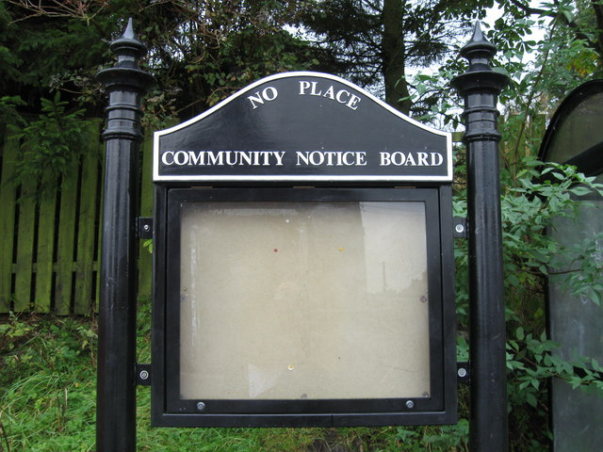
οὐ + τοπος
ou + topos
not + place
Utopia = not a place, no-such-place

Slide 3
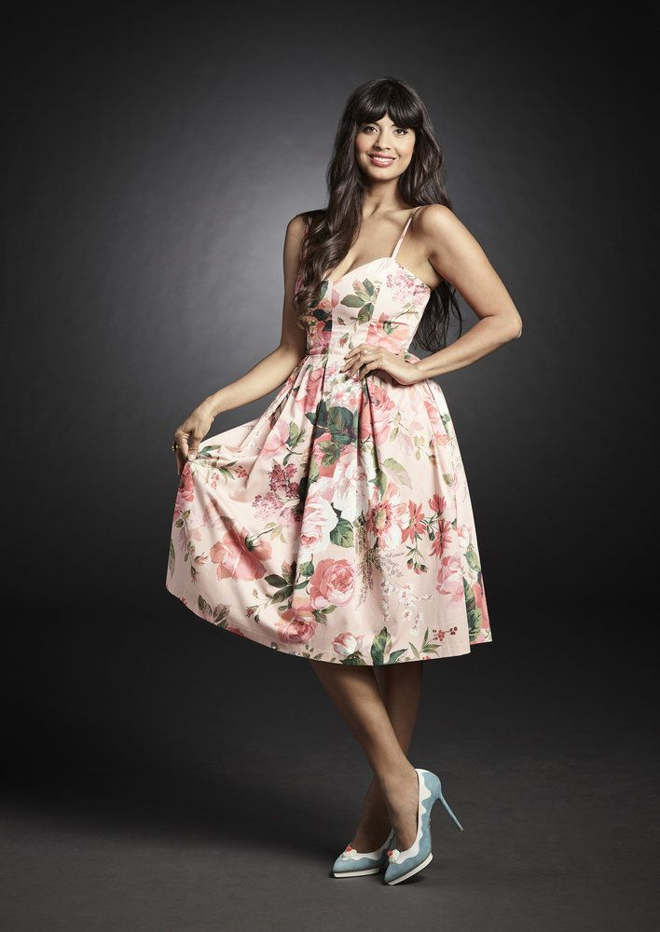
εὐ + τοπος
eu + topos
well, good + place
Utopia = well place, good place

Slide 4
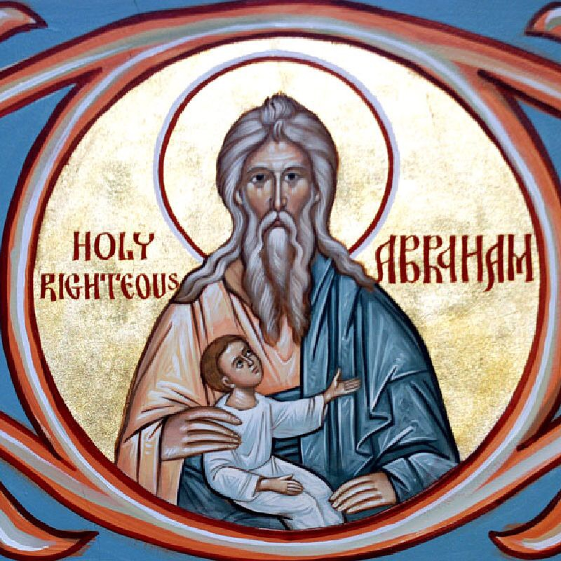

Slide 5
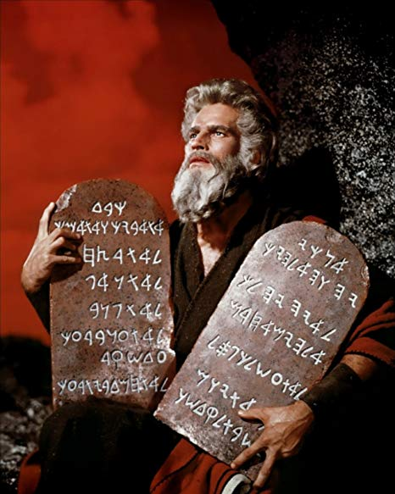

Slide 6


Slide 7
Then God spoke all these words:
I am the Lord your God, who brought you out of the land of Egypt, out of the house of slavery; you shall have no other gods before me.
You shall not make for yourself an idol, whether in the form of anything that is in heaven above, or that is on the earth beneath, or that is in the water under the earth. You shall not bow down to them or worship them; for I the Lord your God am a jealous God, punishing children for the iniquity of parents, to the third and the fourth generation of those who reject me, but showing steadfast love to the thousandth generation of those who love me and keep my commandments.
You shall not make wrongful use of the name of the Lord your God, for the Lord will not acquit anyone who misuses his name.
Remember the Sabbath day, and keep it holy. Six days you shall labor and do all your work. But the seventh day is a Sabbath to the Lord your God; you shall not do any work — you, your son or your daughter, your male or female slave, your livestock, or the alien resident in your towns. For in six days the Lord made heaven and earth, the sea, and all that is in them, but rested the seventh day; therefore the Lord blessed the Sabbath day and consecrated it.
Honor your father and your mother, so that your days may be long in the land that the Lord your God is giving you.
You shall not murder.
You shall not commit adultery.
You shall not steal.
You shall not bear false witness against your neighbor.
You shall not covet your neighbor’s house; you shall not covet your neighbor’s wife, or male or female slave, or ox, or donkey, or anything that belongs to your neighbor.
Exodus 20: 1–17 New Revised Standard Version (NRSV)

Slide 8
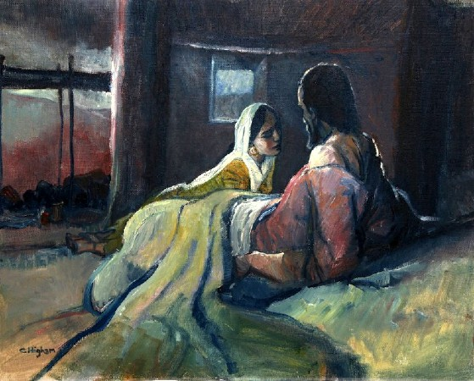

Slide 9
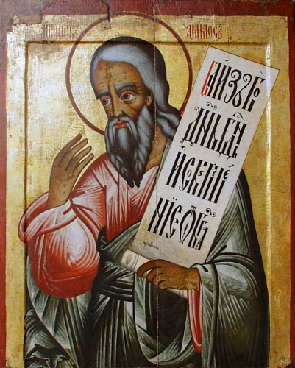

Slide 10
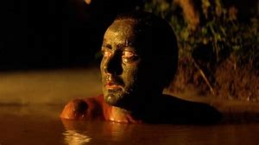

Slide 11
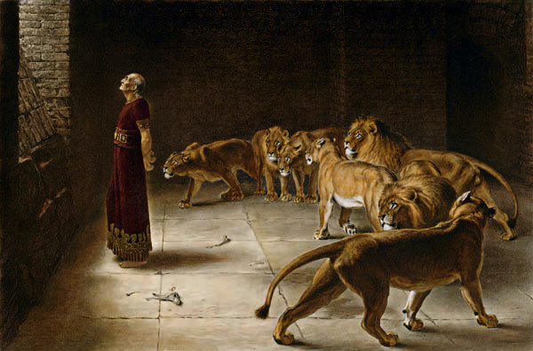

Slide 12
Then I saw a new heaven and a new earth; for the first heaven and the first earth had passed away, and the sea was no more. And I saw the holy city [polis], the new Jerusalem, coming down out of heaven from God, prepared as a bride adorned for her husband. And I heard a loud voice from the throne saying,
“See, the home of God is among mortals.
He will dwell with them;
they will be his peoples,
and God himself will be with them;
he will wipe every tear from their eyes.
Death will be no more;
mourning and crying and pain will be no more,
for the first things have passed away.”
Revelation 21:1–4 NRSV (emphasis added)

Slide 13
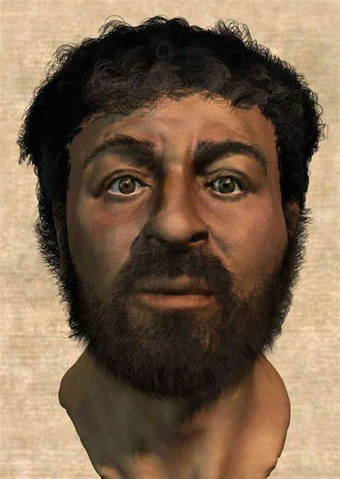

Slide 14
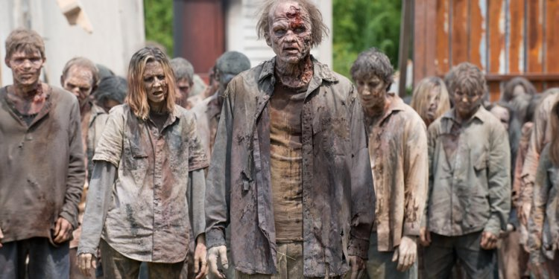
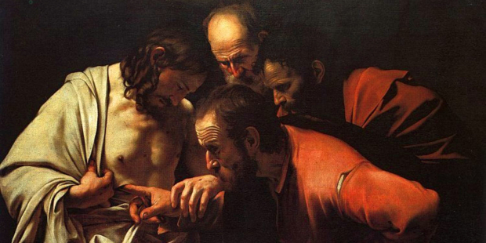

Slide 15
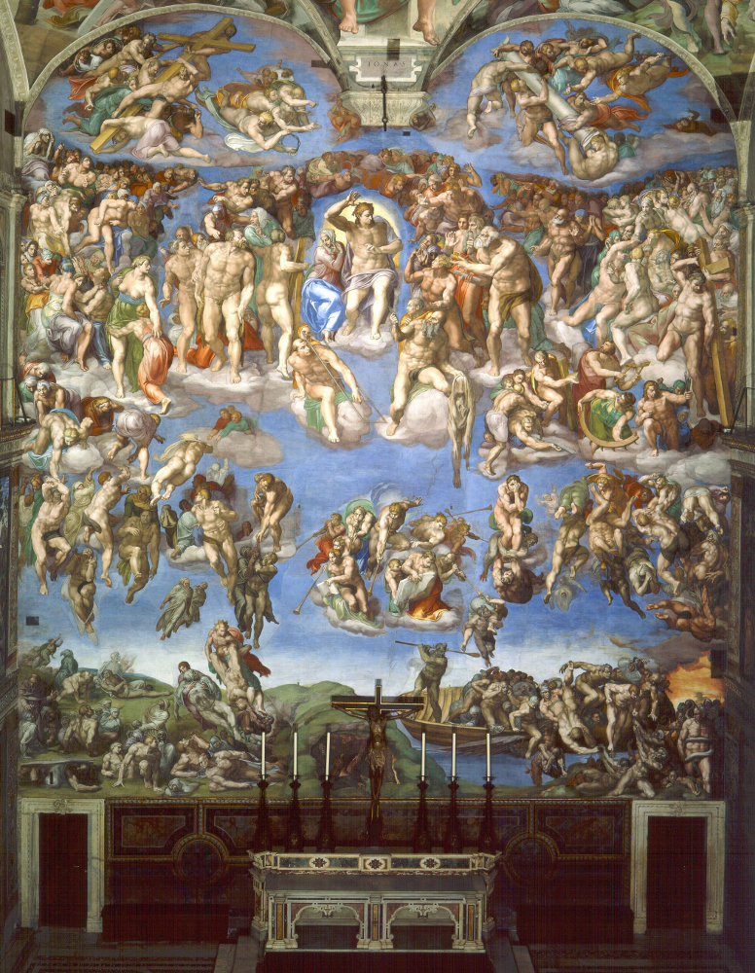

Slide 16
All who believed were together and had all things in common; they would sell their possessions and goods and distribute the proceeds to all, as any had need. Day by day, as they spent much time together in the temple, they broke bread at home and ate their food with glad and generous hearts, praising God and having the goodwill of all the people. And day by day the Lord added to their number those who were being saved.
Acts 2:44–47 NRSV (emphasis added)

Slide 17
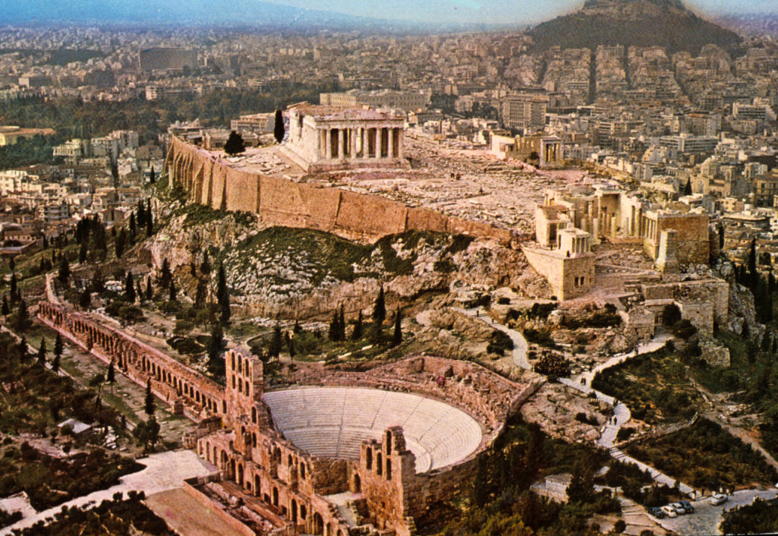

Slide 18
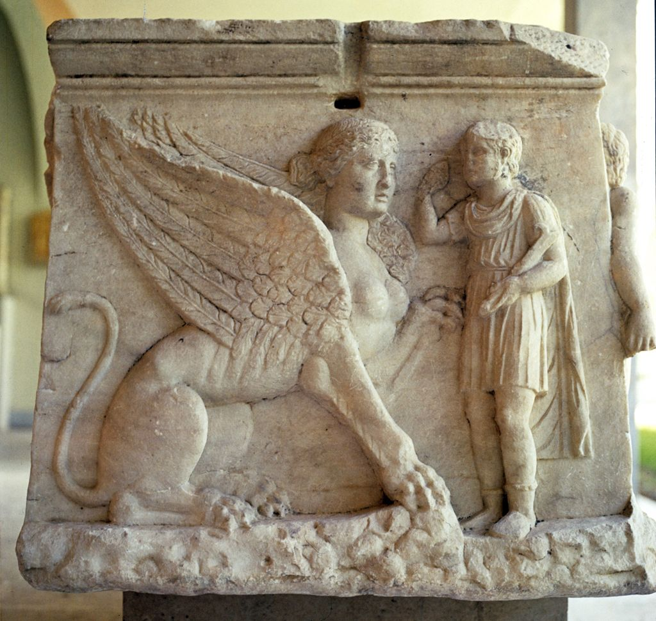

Slide 19
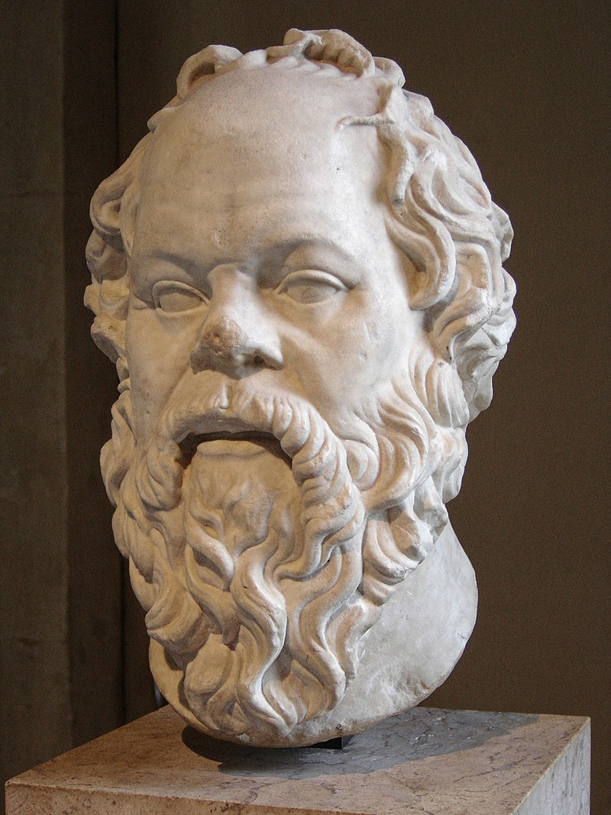
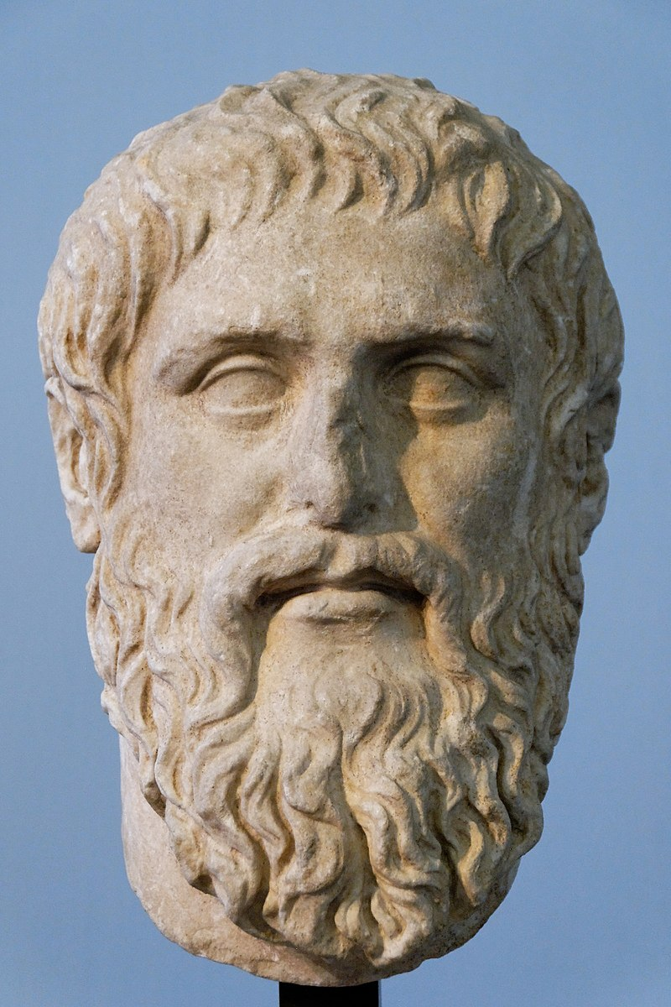

Slide 20
“Unless,” I said, “the philosophers rule as kings or those now called kings and chiefs genuinely and adequately philosophize, and political power and philosophy coincide in the same place … there is no rest from ills for the cities, my dear Glaucon, nor I think for human king, nor will the regime we have now described in speech ever come forth from nature, insofar as possible, and see the light of sun.”
The Republic of Plato, translated by Allan Bloom, 473 c–e (emphasis added)

Slide 21


Slide 22
“[I]n the city whose foundation we have now gone through, the one that has its place in speeches, since I don’t suppose it exists anywhere on earth.”
“But in heaven,” I said, “perhaps, a pattern is laid up for the man who wants to see and found a city within himself on the basis of what he sees. It doesn’t make any difference whether it is or will be somewhere.”
The Republic of Plato, translated by Allan Bloom, 592 a–b (emphasis added)

Slide 23
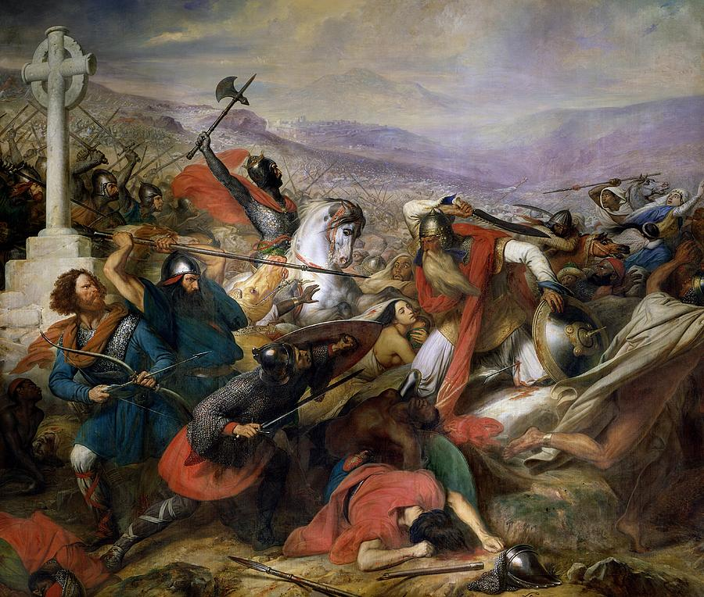

Slide 24
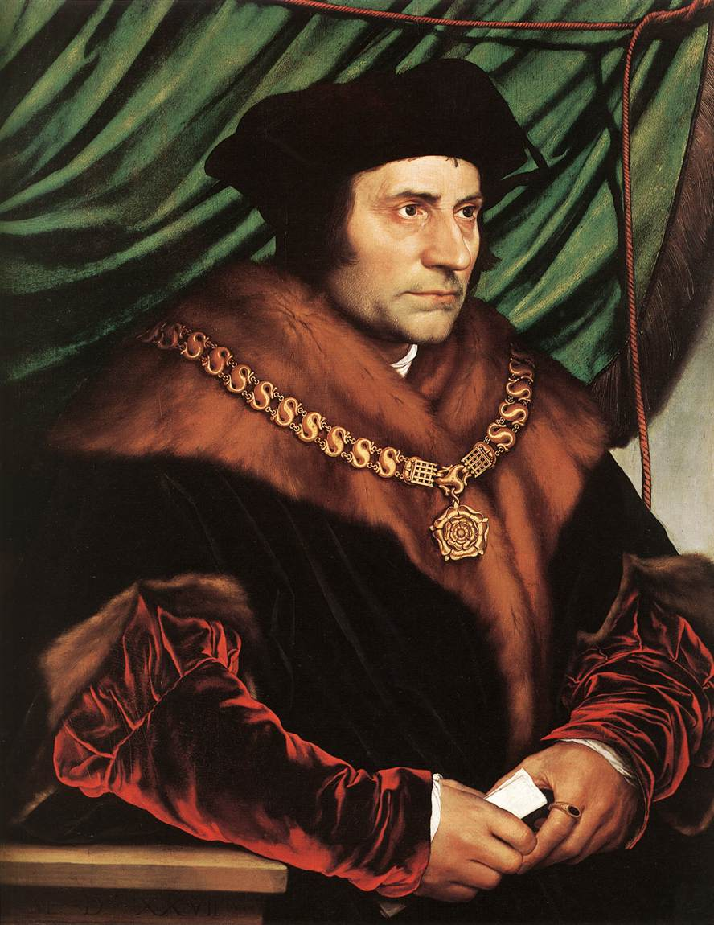

Slide 25
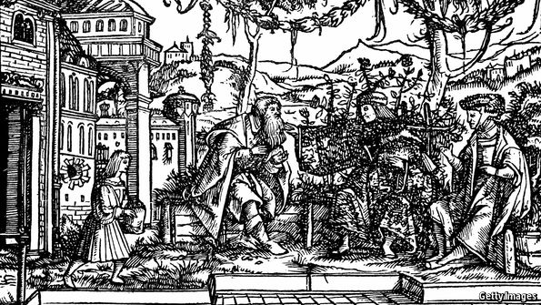

Slide 26
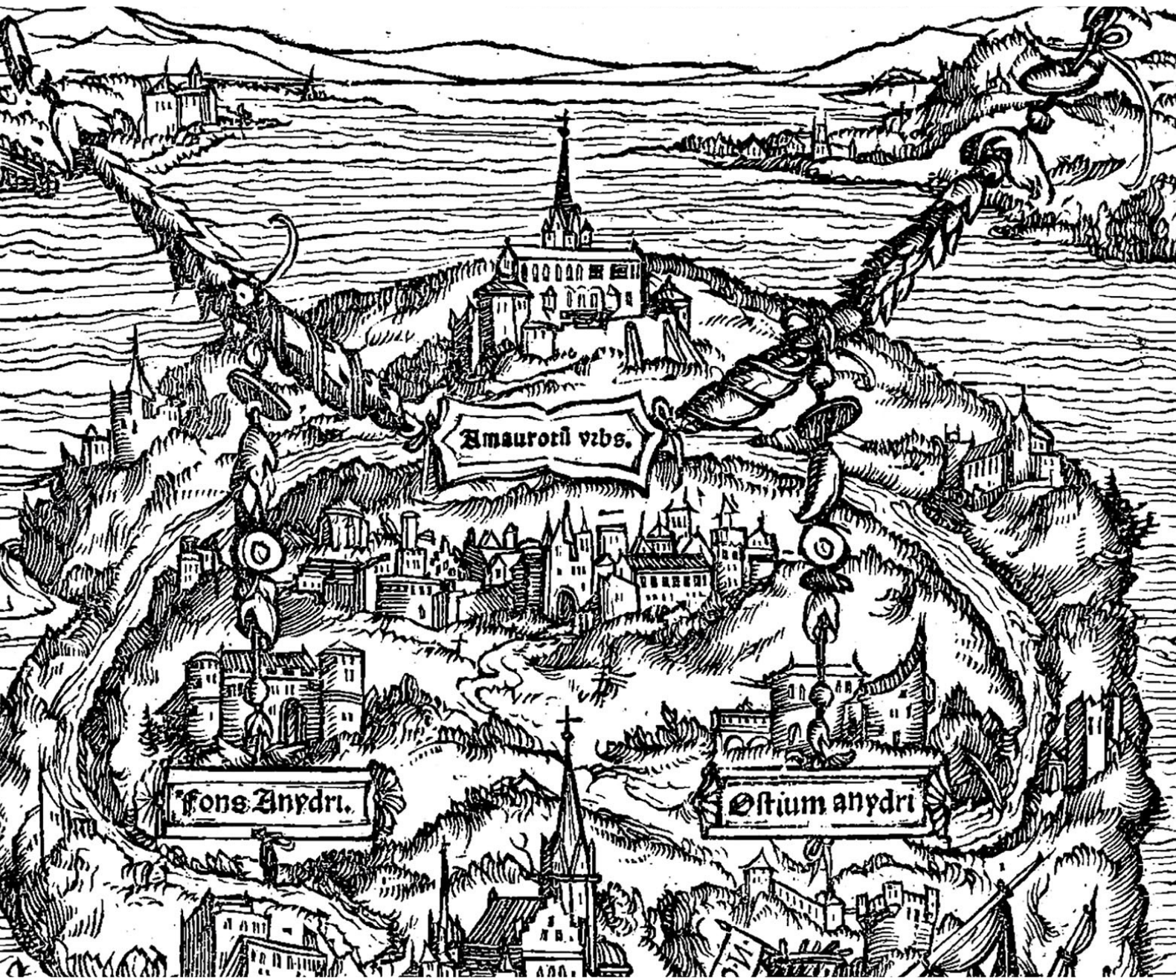

Slide 27
While Raphael was telling all this, I kept thinking of various objections. The laws and customs of [Utopia] seemed to me in many cases perfectly ridiculous. Quite apart from such things as their military tactics, religions, and forms of worship, there was the grand absurdity on which their whole society was based, communism minus money. Now this in itself would mean the end of the aristocracy, and consequently all dignity, splendour, and majesty, which are generally supposed to be the real glories of any nation.
Thomas More, Utopia, translated by Paul Turner, 131–132 (emphasis added).

Slide 28
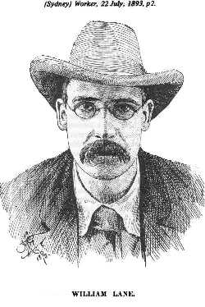
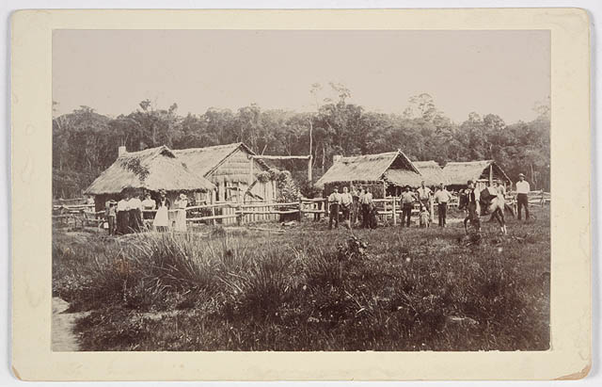

Slide 29
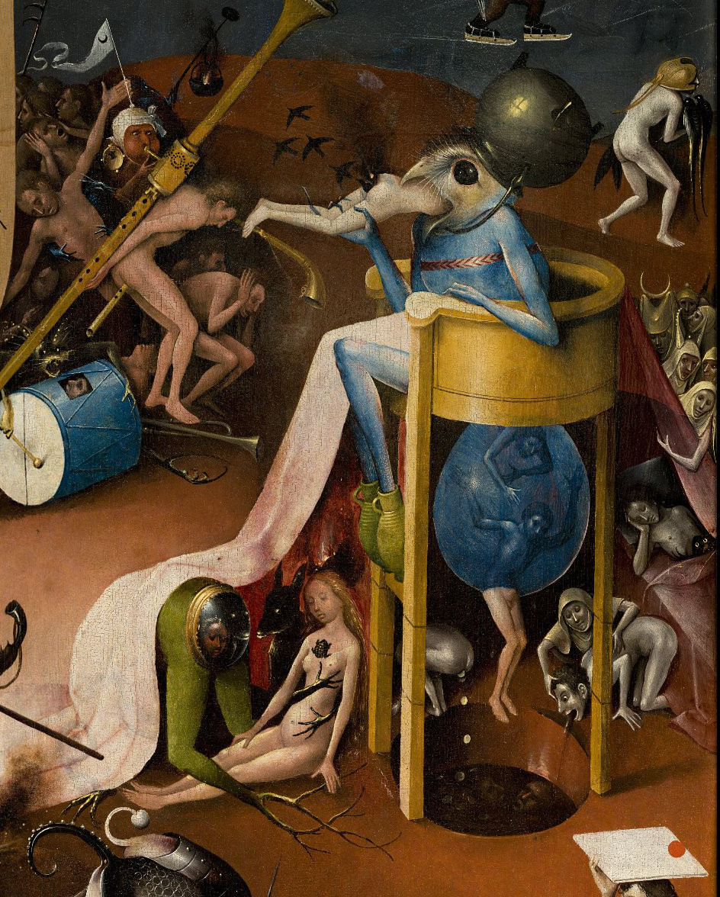
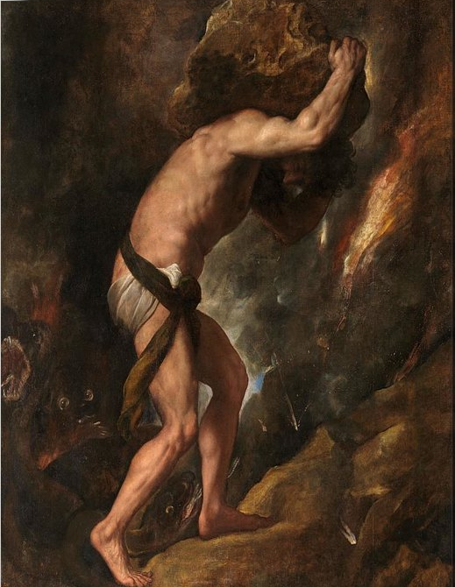

Slide 30

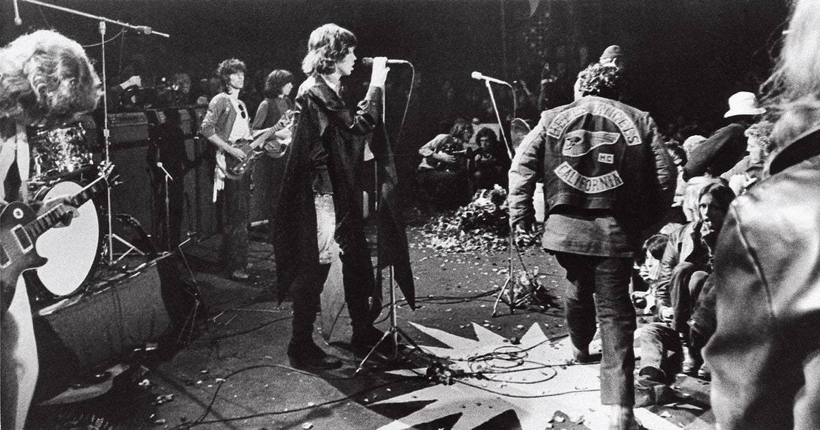

Slide 31
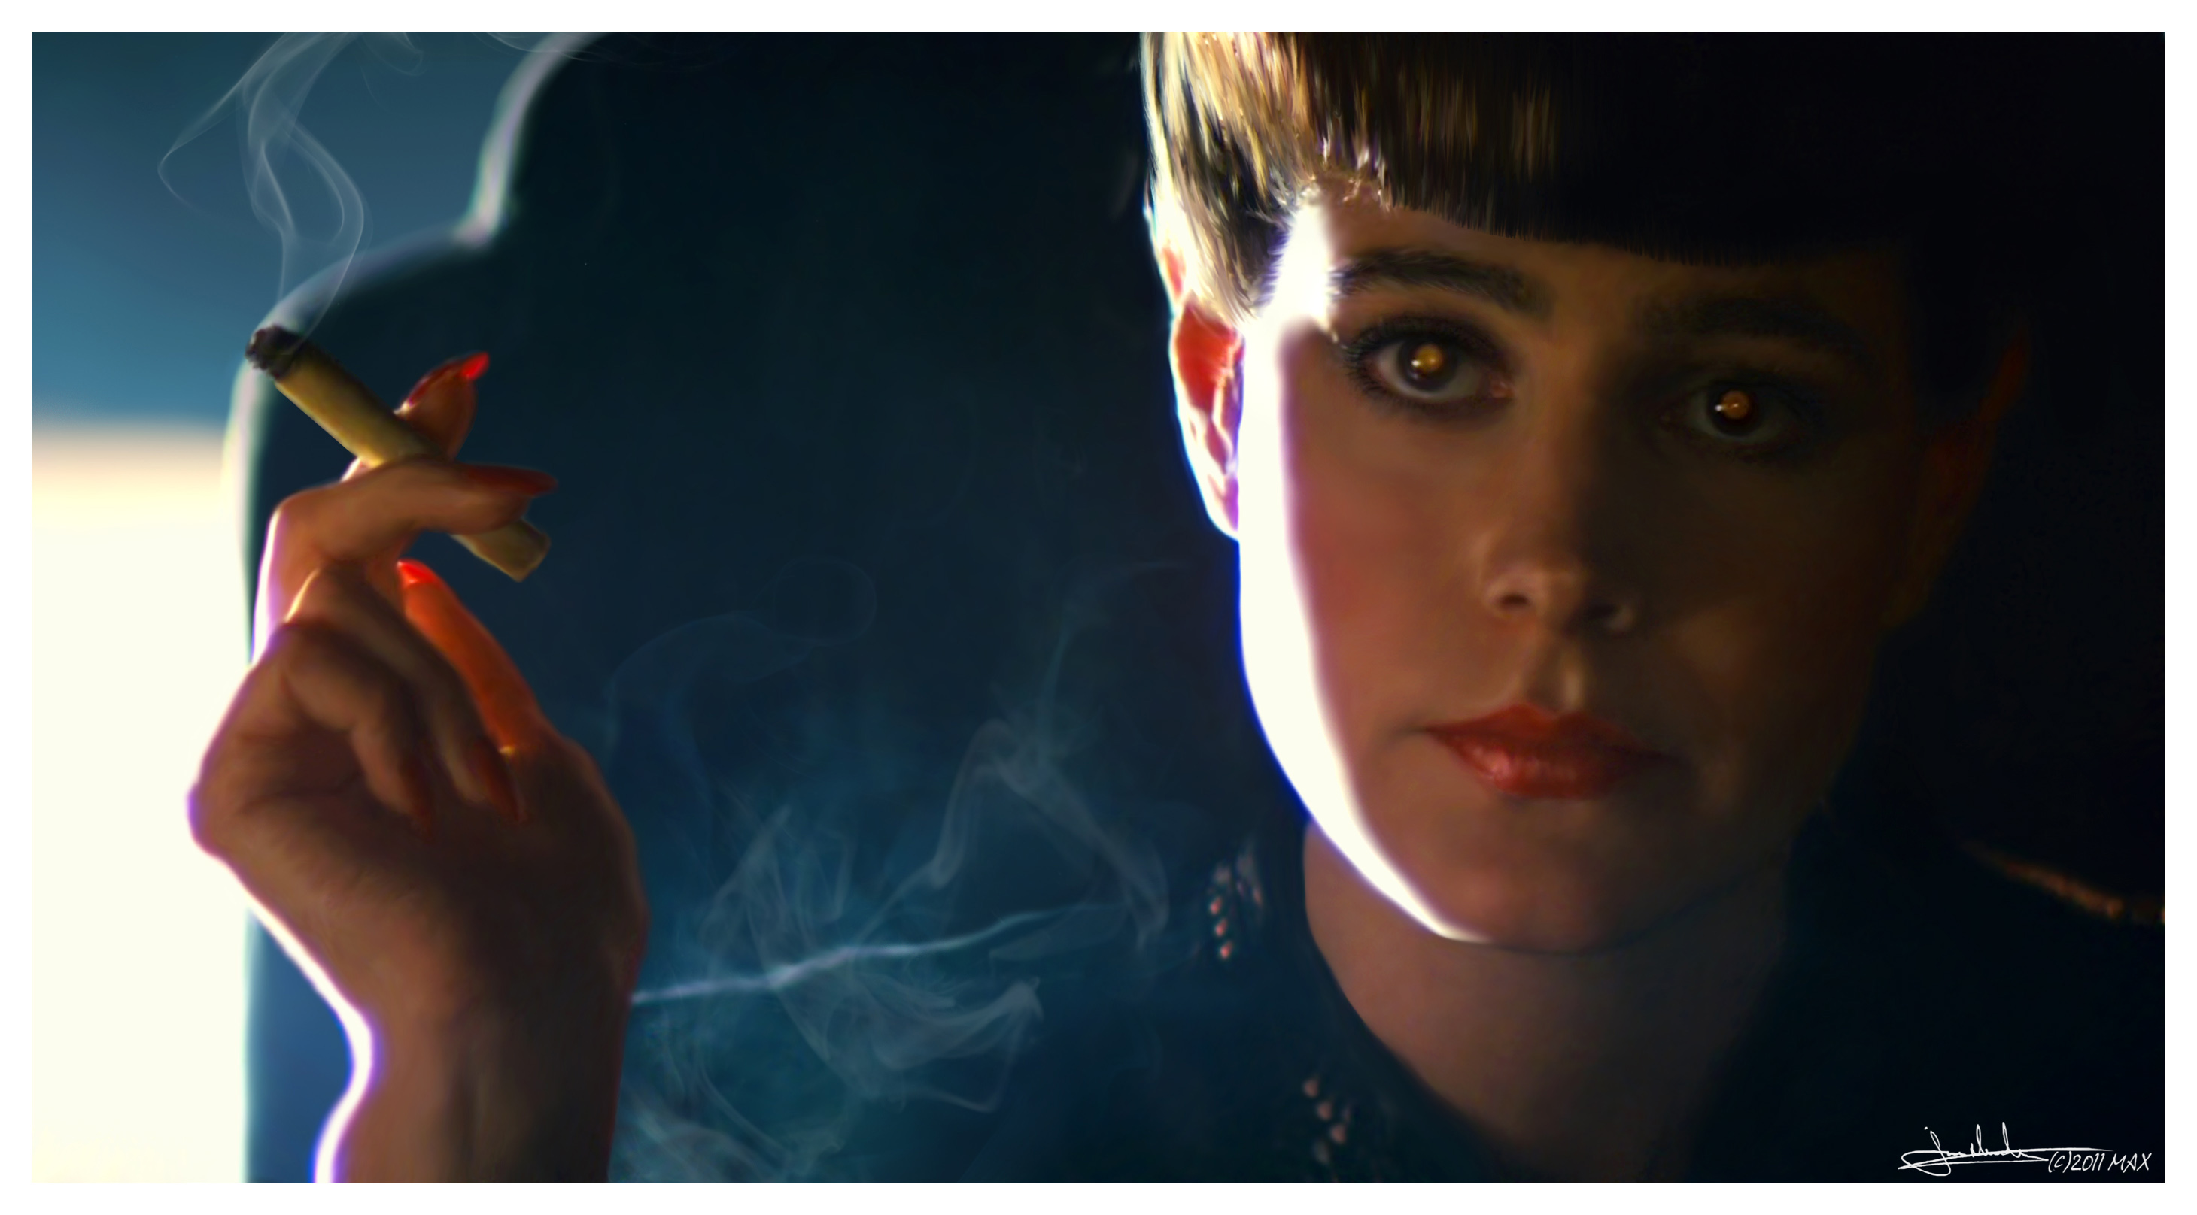
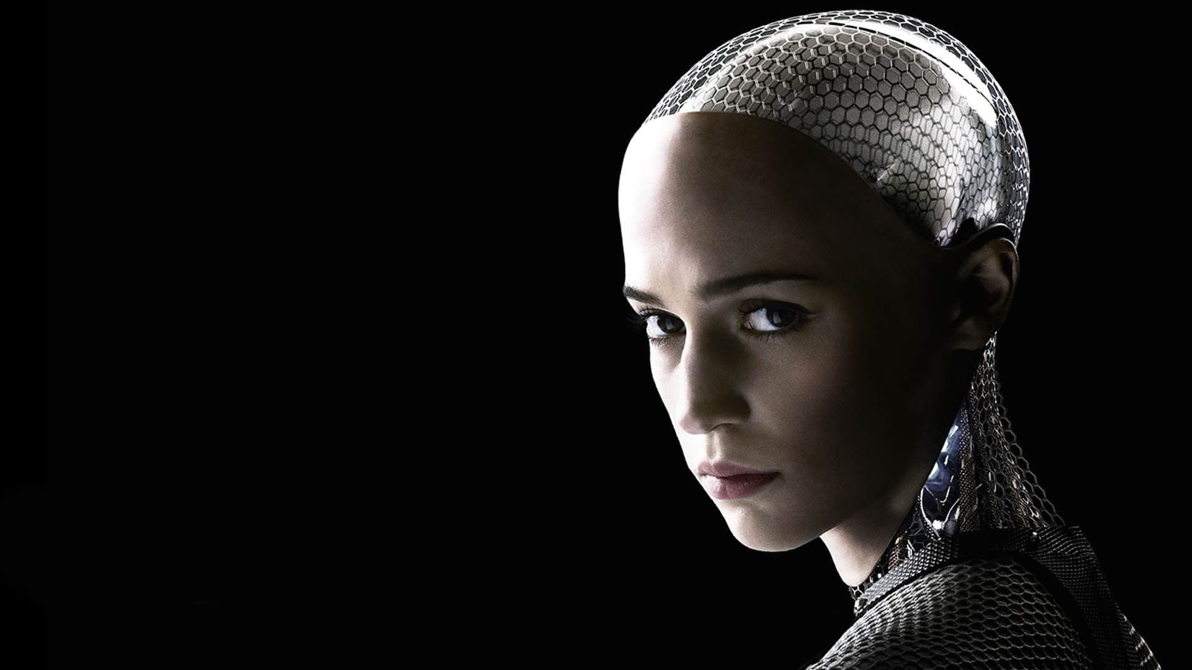

Slide 32
Traditionally, utopia, with its promise of a better future, offered humans the meaning of a different life in times when sense was breaking down and a new meaning was not yet clear. Without stipulating a concrete place and time, utopia offered a story of a better, meaningful future to help us to imagine new ways of living.
Ľubica Učník, Memory and Power: Reflections on the Personal Experience of Utopia, 8.

Slide 33


Slide 34
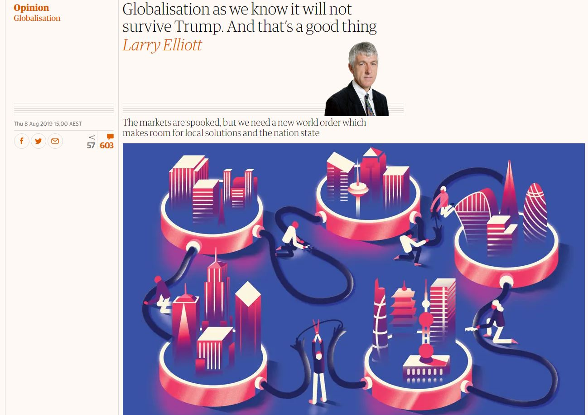
https://www.theguardian.com/commentisfree/2019/aug/08/globalisation-not-survive-trump-markets-new-world-order

Slide 35
In retrospect, the early 1990s marked globalisation’s high point. The Soviet Union had collapsed, former communist countries were becoming market economies, independent central banks were all the rage and a multilateral trade deal was concluded after more than seven years of negotiations. Europe’s integrationist project was in full swing, with preparations under way for a single currency. Politics during the 1990s was dominated by parties of the centre right and centre left, pursuing broadly similar economic policies: budgetary discipline, liberalising capital flows, encouraging the incursion of the market into sectors hitherto off limits. Whether in the developed countries of Europe or the emerging markets of Latin America, orthodoxy reined supreme. Sure, it was accepted that there were teething problems with the new world order, but the cold war was over and Russia no longer a threat. America would use its unchallenged military might to police the world and keep factories booming internationally through its willingness to act as the consumer of last resort.

Slide 36
Little of this utopian vision has survived. There has not been a completed set of multilateral trade talks since the Uruguay round was wrapped up in late 1993, in large part because this was the last time the US and the EU were able to carve out a deal to their mutual interest and then impose it on the rest of the world.

Slide 37
What is most crippling in our time is the universal belief … that the historic alternatives to capitalism have been proven unviable and impossible, and that no other socio-economic system is conceivable, let alone practically available.
Fredric Jameson, Archaeologies of the Future: the Desire called Utopia, xii

